Slide 2
FIT 152 Fundamentals of Information Technology
Lecture 10
Topic 5: Application domains

Slide 3
FIT 152: Module outcomes
Upon successful completion of this course, the student will be able to:
Demonstrate an understanding of the relationship between IT and related and informing disciplines.
Demonstrate insight in the history of computing technology, and an understanding of the Internet, and the World-Wide Web, as well as the components of an IT system and how they interrelate.
Demonstrate an understanding of complexity in an information technology environment and how and why it occurs.
Demonstrate an understanding of why life-long learning and continued professional development is critical for an IT professional.
Illustrate the use of information and communication technologies to solve problems.
Demonstrate an understanding of how and to what extent IT has changed various application domains.

Slide 4
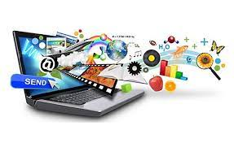
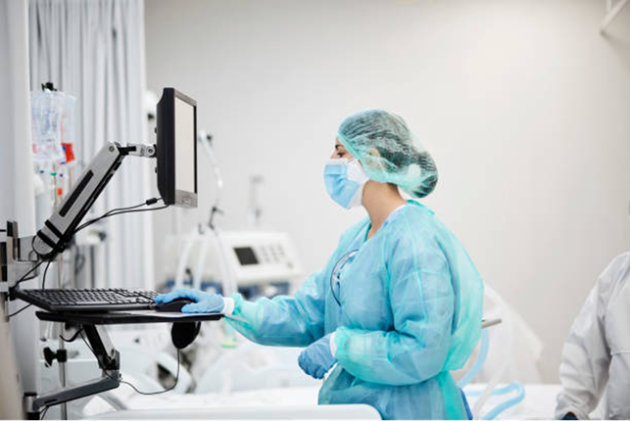
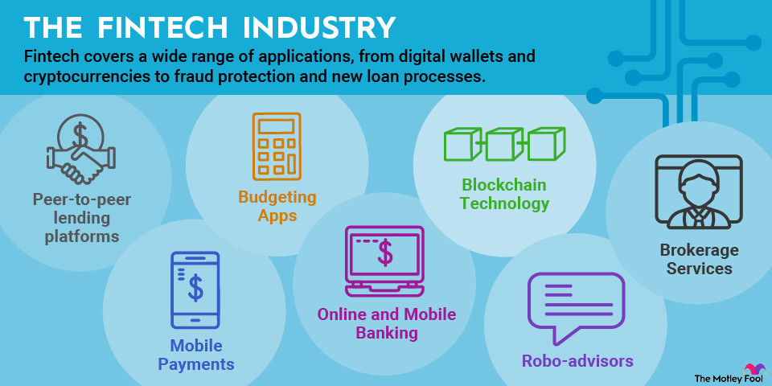
Application domains
Read Williams, section 1.2
Vermaat, p 1-39
Education
Learning Management Systems
E-learning or online learning
Virtual tours
3-D printers
Health
CT scans, MRI, X-ray
Robots
Patient records
Pacemakers
Labels for medicine, ID bracelets
Finance
Automatic transfers
Digital money
Online banking
Cryptocurrency
Notes:
Education:
Learning Management Systems (LMS):
Platforms like Moodle, Canvas, or Blackboard streamline course administration, content delivery, and student interaction.
E-learning or Online Learning:
Distance education opportunities via platforms like Coursera, Khan Academy, or Udemy democratize learning.
Virtual Tours:
Immersive experiences that simulate real-world environments, enhancing education in fields like history, science, and art.
3-D Printers:
Tools for prototyping, creating educational models, and fostering hands-on learning in STEM disciplines.
Health:
Medical Imaging (CT scans, MRI, X-ray):
IT-driven advancements in imaging technology facilitate accurate diagnosis and treatment planning.
Robotics:
Surgical robots assist in minimally invasive procedures, enhancing precision and reducing recovery times.
Patient Records:
Electronic Health Records (EHRs) streamline data management, ensuring comprehensive and accessible patient information.
Pacemakers:
Implantable medical devices regulated and monitored through IT systems, enhancing patient care and safety.
Labels for Medicine, ID Bracelets:
Barcoding and RFID technologies ensure accurate medication administration and patient identification, reducing errors.
Finance:
Automatic Transfers:
IT enables seamless fund transfers between accounts, automating payments and payroll processes.
Digital Money:
Cashless transactions via mobile wallets, cards, and payment gateways, offering convenience and security.
Online Banking:
Web and mobile banking platforms provide anytime, anywhere access to financial services, revolutionizing personal finance management.
Cryptocurrency:
Blockchain technology underpins digital currencies like Bitcoin and Ethereum, offering decentralized and secure financial transactions.

Slide 5
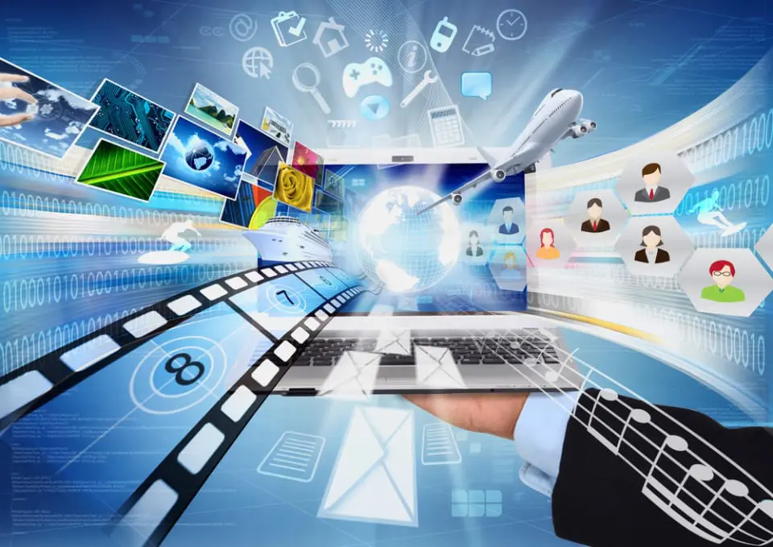

Application domains (cont)
Read Williams, section 1.2
Vermaat, p 1-39
Entertainment
Downloading music, movies, newspapers, games, etc
Streaming
Animation
Artificial Intelligence (AI)
Government
Electronic voting
Income tax – South African Tax Service (SARS)
Vehicle Registration
Police Services
Notes:
Entertainment:
Downloading Music, Movies, Newspapers, Games, etc.:
Platforms like iTunes, Netflix, and Steam provide convenient access to entertainment content, shaping consumer behaviour and distribution models.
Streaming:
Services like Spotify, Netflix, and Twitch offer real-time content delivery, revolutionizing how we consume media and interact with creators.
Animation:
Animation studios utilize IT tools and software to create visually stunning and immersive storytelling experiences for audiences worldwide.
Artificial Intelligence (AI) Innovation in Local Government:
AI applications in local government streamline processes, optimize resource allocation, and improve citizen services, enhancing efficiency and transparency.
Government:
Electronic Voting:
IT enables secure and efficient electoral processes, ensuring accuracy and accessibility in voting systems.
Income Tax – South African Tax Service (SARS):
Online tax filing and management systems simplify tax compliance for individuals and businesses, enhancing revenue collection and transparency.
Vehicle Registration:
Digital platforms streamline vehicle registration processes, reducing administrative burden and improving service delivery.
Police Services:
IT tools and systems support law enforcement agencies in crime prevention, investigation, and community engagement, enhancing public safety.
Jobs and Careers:

Slide 6
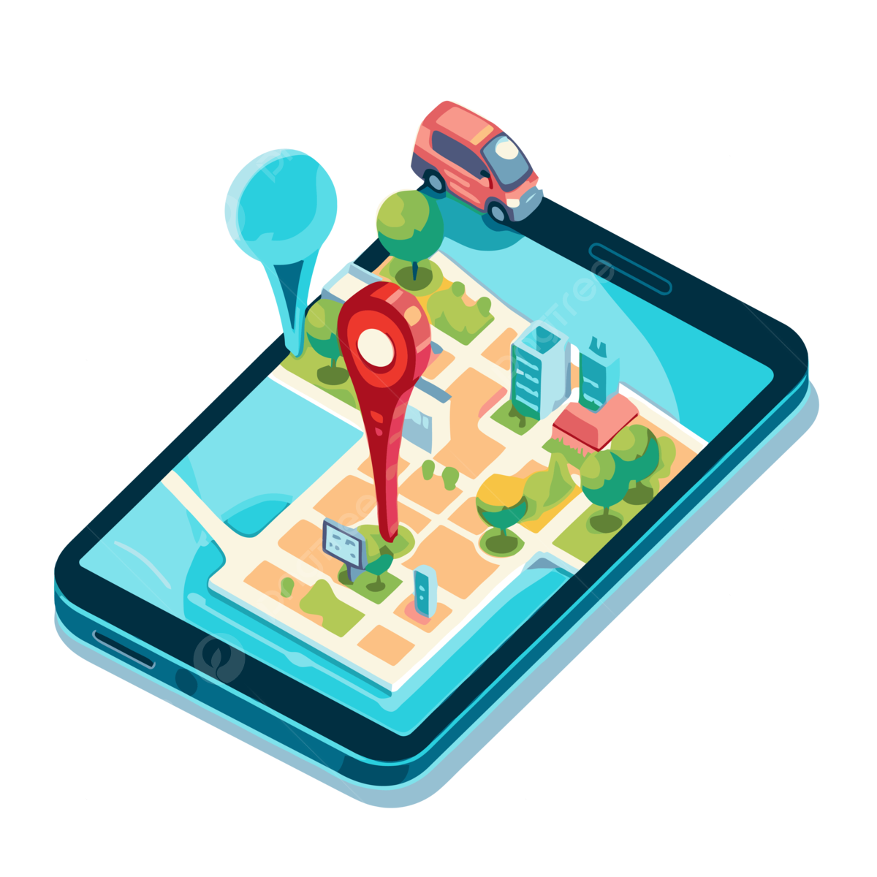

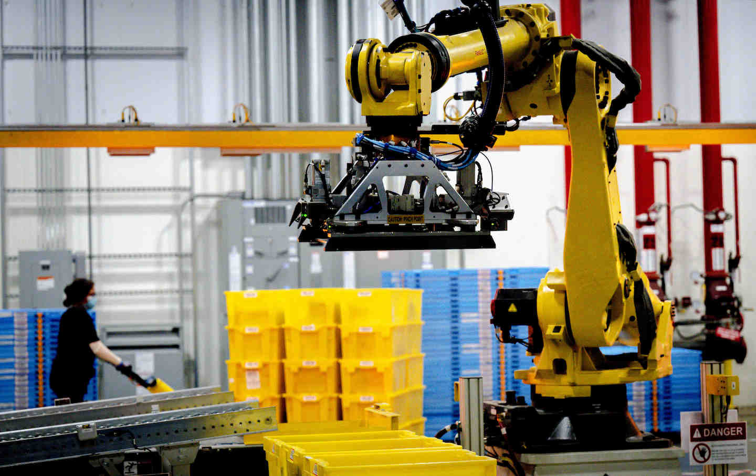
Application domains (cont)
Read Williams, section 8.5
Vermaat, p 1-39
E-commerce / retail
Takealot.com
Netflorist
B2B, B2C and C2C
Travel
GPS
Search and compare flight tickets and prices
Publishing
Online reading
Blogs, vlogs, wikis
Manufacturing
Assembly of products
Industrial robots
Notes:
E-commerce / Retail:
Online marketplaces like Takealot.com, Amazon, and eBay facilitate commerce between businesses and consumers, transforming retail experiences.
B2B, B2C, and C2C:
Digital platforms enable business-to-business, business-to-consumer, and consumer-to-consumer transactions, fostering economic growth and entrepreneurship.
Travel:
GPS:
Global Positioning System (GPS) technology powers navigation and location-based services, enhancing travel convenience and safety.
Search and Compare Flight Tickets and Prices:
Online travel agencies and comparison websites simplify travel planning, offering comprehensive options and competitive pricing.
Publishing:
Online Reading:
E-books and digital publishing platforms like Kindle, Scribd, and Google Books redefine how we access and consume written content, promoting literacy and knowledge sharing.
Blogs, Vlogs, Wikis:
User-generated content platforms empower individuals and communities to share insights, experiences, and expertise, fostering collaboration and creativity.
Manufacturing:
Assembly of Products:
IT-driven automation and robotics optimize manufacturing processes, increasing efficiency and precision in product assembly.
Industrial Robots:
Robotics technology enhances manufacturing productivity and safety, enabling complex tasks and customization in production lines.

